Slide 1

Email Classification with Random Forest
This presentation explores the development and deployment of a Python-based email classification system utilizing a Random Forest algorithm for spam detection. We'll walk through the project methodology, including data preprocessing, model training, and results.
By Sameer Singh Bhandari University Roll No: 2319495 Section: I2
B. Tech CSE

Slide 2
Introduction and Problem Statement
Email Classification
Problem Statement
Email classification refers to the task of automatically categorizing emails into different classes, such as spam, personal, or work-related.
Spam detection is a critical challenge due to the constantly evolving nature of spam tactics and the high volume of emails received daily.

Slide 3
The Need for Efficient Spam Filtering
Email Overload
Time-Consuming
Security Risks
Email has become an essential communication tool, but it's often overwhelmed by spam.
Manually sorting through spam emails takes time and effort, hindering productivity.
Spam emails can carry malware and phishing attacks, posing security risks to users.

Slide 4
Our Approach: Combining Python & Machine Learning
Python
Random Forest
Scikit-learn
Leveraging the power of Python for data manipulation, preprocessing, and model development.
Utilizing a Random Forest algorithm for its accuracy and ability to handle high-dimensional data.
Employing scikit-learn's comprehensive machine learning library for efficient implementation.

Slide 5

Data Preprocessing: Preparing for Training
Text Cleaning
Stop Word Removal
Removing special characters, punctuation, and HTML tags to focus on the content.
Eliminating common words (like "the," "and") that have little meaning for classification.
Vectorization
Converting the cleaned text into numerical vectors using the CountVectorizer technique.

Slide 6
Model Training: Building the Spam Detector
Training/Test Split
Random Forest Algorithm
Evaluation Metrics
Dividing the preprocessed dataset into training and testing sets for model evaluation.
Training the model using a Random Forest classifier to identify patterns in the data.
Assessing the model's performance using metrics like accuracy, precision, and recall.

Slide 7
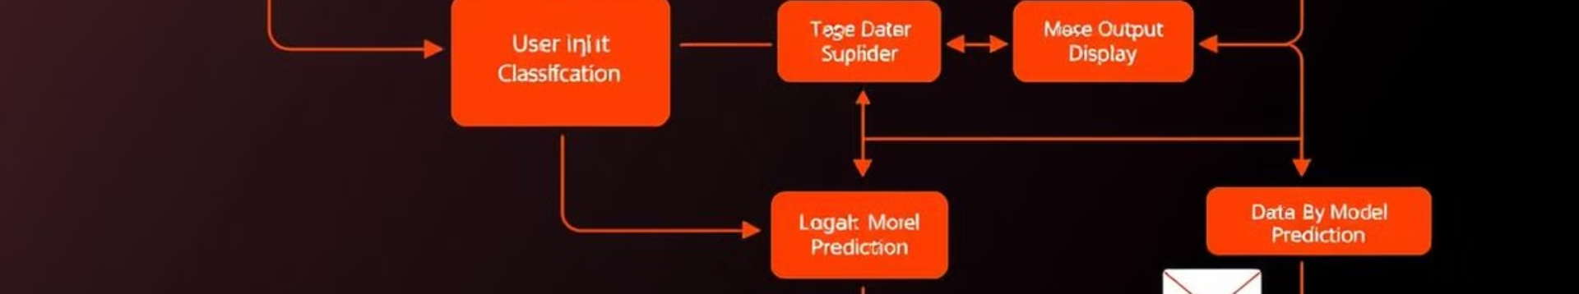




System Workflow: From Input to Output
User Input
Backend Processing
Model Prediction
Frontend Output
A user enters an email into the system's frontend.
The Flask backend processes the input, cleans, and vectorizes the text.
The trained Random Forest model predicts whether the email is spam or ham.
The results, including prediction and confidence score, are displayed on the React frontend.

Slide 8
Model Performance: Achieving High Accuracy
93%
95%
89%
Accuracy
Precision
Recall
The model achieved a 96% accuracy in classifying spam emails.
The model correctly identifies spam emails with a 98% precision rate.
The model successfully captures 89% of spam emails.

Slide 9
Conclusion: A Robust Solution for Spam Detection
This project successfully developed and deployed a Python-based email classification system using a Random Forest algorithm. The system achieves high accuracy in detecting spam emails, effectively reducing the burden on users. Future enhancements could include exploring other machine learning algorithms, incorporating user feedback, and enhancing the system's ability to adapt to evolving spam patterns.

